Slide 1
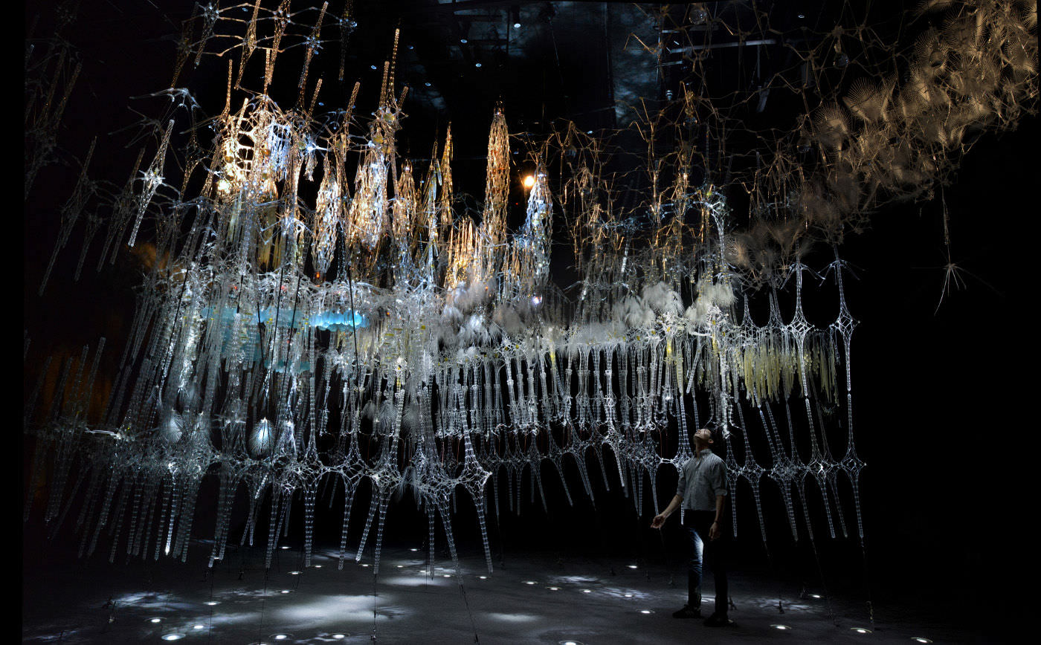
Curiosity-Based Learning Algorithm for Interactive Art Sculptures
Image courtesy of Philip Beesley Architect Inc.
Matthew Tsz Kiu Chan Feb 09, 2016

Slide 2
Outline
Introduction
Curiosity-Based Learning Algorithm
Interactive Control System
Experimental Validations
User Study
Conclusions and Future Work

Slide 3

Motivations
It is part of the Living Architecture Systems Group (LASG).
We aims to create large-scale interactive architectural installations that exhibit life-like qualities.

Slide 4

Aurora Interactive Sculpture
Notes:
Previous PBAI work had many sensors and actuators. It also have complex prescripted behaviours
However, it is non-varying. The sculpture doesn’t make its own decision and generate behaviours
Practically, it require the designer to make a decision on what’s life-like or interesting. Time consuming to program.

Slide 5
Objectives
To enable the sculptural system to generate varying behaviours autonomously.
To characterize these autonomous behaviours and the system’s responses to human interactions.
To study the responses and perceptions of the users.

Slide 6
Approach

Slide 7
Related Work
Previous PBAI work had many sensors and actuators. It also have complex prescripted behaviours
However, it is non-varying. The sculpture doesn’t make its own decision and generate behaviours
Practically, it require the designer to make a decision on what’s life-like or interesting. Time consuming to program.
Oudeyer IAC mimics curiosity by introducing a reinforcement learning algorithm that uses the rate of reduction of error as reward.
CBLA is based on IAC but for a much larger system.

Slide 8
Background
PBAI/LASG builds near-living architecture.
They build living architectures that interact with people. Those are very large scale architectural sculpture.
In the project, we want to give it more characteristic of a living creature by enabling it to generate its own behaviours and adapt and study how people respond to that
we want to study the learning process itself and study how curiosity aﬀects the way that the system explores the state-space.
We want to build sculpture that exhibit learning behaviours

Slide 9
Contributions
An algorithm for generating autonomous behaviours for a large scale kinetic sculptural system during interaction with an occupant was developed.
An experimental test bed was developed to enable validation.
A user study that examined how human occupants perceive the behaviours of the sculpture and respond in turn was conducted. We analyzed the relationships between the behaviours of the system and the users’ perceptions.

Slide 10
Curiosity-Based Learning Algorithm
We related the output range to knowledge gain potential to make the learning more visible to viewers
Overall block diagram
Sub system block diagrams
Highlights of differences between CBLA and IAC
Region splitter
Action selection
Multi-Node CBLA System
Use shared inputs and virtual inputs to connect Nodes

Slide 11
Interactive Control System
Overall architecture
Important units
Multi-cluster test bed
Network configurations
Prescripted behaviours

Slide 12
Experimental Validations
Demonstrating exploration pattern in Single Node mode
Single Cluster Experiment
Response from Trigger
Multi-Cluster Experiment
Compare between activation concentrate closer to cluster where the trigger was placed
Spontaneous activation
Sensitivity
Response time

Slide 13
User Study
Objectives, research questions, hypothesis
Set-up, recruitments
Procedures
CBLA is less interesting than Prescripted
Positive correlation between activation level and interest level, but not proximal
Presceived Responsivedness positive correlate with interest level
Discussions, sample of response

Slide 14
Conclusions and Future Work
CBLA System
Different parameters and settings
Different model
Merging of regions
Interactive Control System
Distributed computing
More robust database
User study
Study effect of response time
Different configuration
Do more studies
Need better user study done under typical setting and longer term
Study effects of user’s expectation

